Slide 1







Can Technical Analysis Help to Predict Future Gold Price? Part II
Created by Anvar Akhunjanov
11849406

Slide 2
Table of Contents of Bachelor Thesis:
Abstract
1. Introduction
1.1. Background of the Study
1.2. Aim
1.3. Limitations
1.4. Thesis Structure
2. Theoretical Framework
2.1. Efficient Market Hypothesis (EMH) 2.2. Technical Analysis 2.2.1. Description of Technical Analysis 2.2.2. Technical vs. Fundamental Forecasting 2.2.3. Diversification of Technical Analysis Indicators 2.2.4. Bullish and Bearish Markets, Momentum 2.3. Moving Averages 2.3.1. Simple Moving Average (SMA) 2.3.2. Weighted Moving Average (WMA) 2.3.3. Exponential Moving Average (EMA).
3. Research Methods
3.1. Research Variables
3.2. Data Collection and Analysis
3.3. Methodology
4. Results
4.1. Quantitative Findings
4.2. Comparison
5. Conclusion
6. References

Slide 3
Research
Data
Limitations
-Gold dayly performance at period from 01.10.2018 till 01.05.2020
31.05.2018 till 28.05.2021 =>
-Number of elements = 742
-Number of days to forecast = 40
World Gold Council | https://www.gold.org/
Variables
A… Actual value at the day n
F… Estimated Price
k… Weighting
s… Smoothing parameter
Aim
-To identify best-performing indicator out of 3 given
-To detect if the MAPE low enough to be trustworty

Slide 4
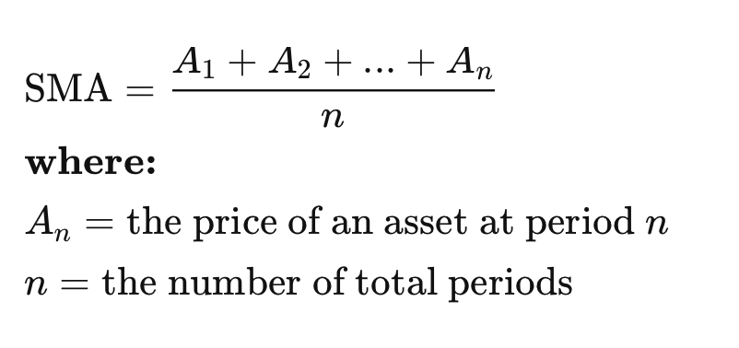
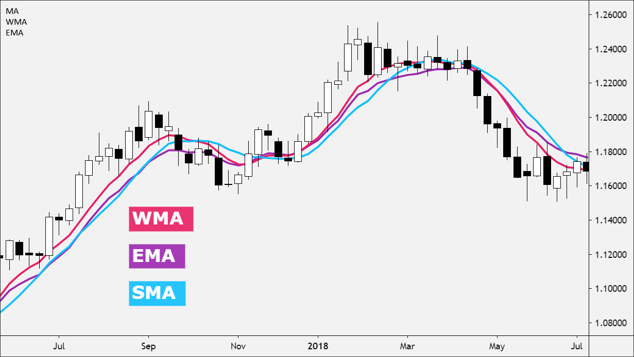
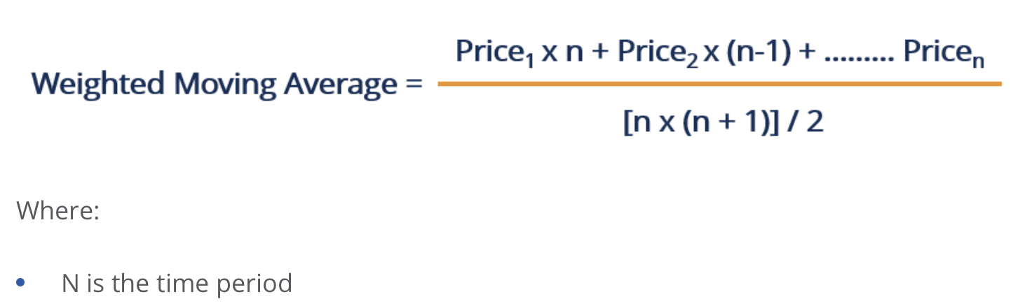
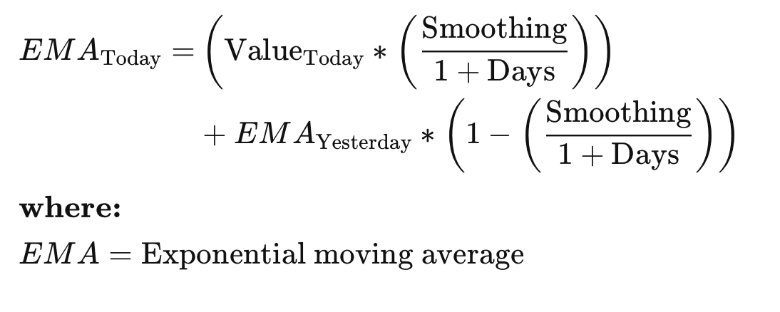
Moving Averages

Slide 5
SMA
DATE | PRICE | SMA | Error | Absolute Value of Error | Square of Error | Absolute Values of Errors Divided by Actual Values
D | P | F | A-F | |A-F| | |A-F|^2 | |(A-F)/A|
2018-07-26 | 1.228,25 | 1264,22 | -35,97 | 35,97125 | 1.293,93 | 0,029286587
2018-07-27 | 1.223,95 | 1262,29 | -38,34 | 38,34375 | 1.470,24 | 0,031327873
2018-07-30 | 1.223,80 | 1260,53 | -36,73 | 36,7275 | 1.348,91 | 0,030011031
…
TOTALS |  |  | 11.961,44 | 29585,11 | 2.062.671,74 | 18,44949604
Best conditions:
Stable Trends/Market
Longer Time Frames

Slide 6
EMA
DATE | PRICE | EMA | Error | Absolute Value of Error | Square of Error | Absolute Values of Errors Divided by Actual Values
D | P | F | A-F | |A-F| | |A-F|^2 | |(A-F)/A|
2018-07-26 | 1.228,25 | 1264,22 | -35,97 | 35,97125 | 1.293,93 | 0,029286587
2018-07-27 | 1.223,95 | 1262,26 | -38,31 | 38,30679878 | 1.467,41 | 0,031297683
2018-07-30 | 1.223,80 | 1260,38 | -36,58 | 36,58085738 | 1.338,16 | 0,029891206
…
TOTALS |  |  | 10.850,63 | 25.055,57 | 1.476.909,75 | 15,69
Best conditions:
Volatile Markets
Shorter Time Frames
Fast-Reaction Needs
Smoothing parameter s
(2/(1+40)) = 0,048780488

Slide 7
WMA
DATE | PRICE | SMA | Error | Absolute Value of Error | Square of Error | Absolute Values of Errors Divided by Actual Values
D | P | F | A-F | |A-F| | |A-F|^2 | |(A-F)/A|
2018-07-26 | 1.228,25 | 1250,33 | -22,08 | 22,08085366 | 487,56 | 0,017977491
2018-07-27 | 1.223,95 | 1248,58 | -24,63 | 24,62615854 | 606,45 | 0,020120232
2018-07-30 | 1.223,80 | 1246,71 | -22,91 | 22,90573171 | 524,67 | 0,018716891
…
TOTALS |  |  | 8.490,40 | 22.720,63 | 1.287.640,37 | 14,15
Best conditions:
Recent Data Emphasis
Starting trends
Weighting k
The farthest day = 1/820
The closest day =40/820=1/41
(20 times greater impact)

Slide 8
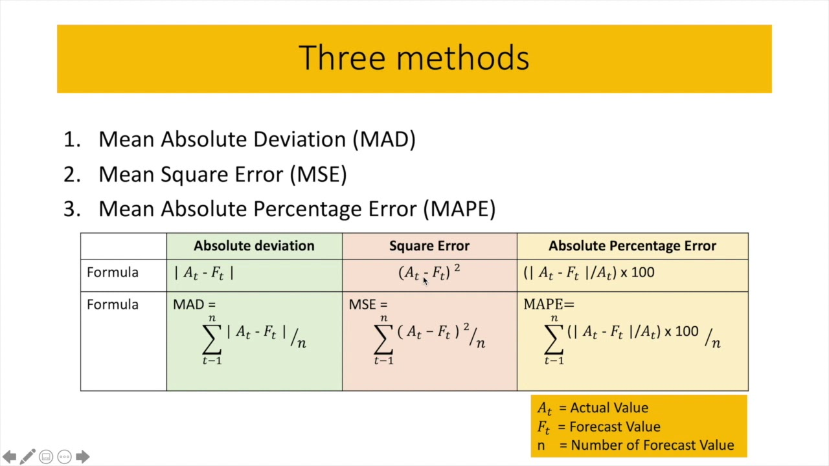
EMPIRICAL FINDINGS
 | SMA | EMA | WMA
MAD | 39,87 | 33,77 | 30,62
MSE | 2.779,88 | 1.990,44 | 1.735,36
RMSE | 52,72 | 44,61 | 41,66
MAPE | 2,49 | 2,11 | 1,91

Slide 10
Comparison
 | SMA | EMA | WMA
MAD | 2.58% | 2.19% | 1.99% | 1.541,99
MSE | 4.40% | 3.15% | 2.83% | 63.125,72
RMSE | 5.93% | 5.02% | 4.69% | 888,75
MAPE | 2,49 | 2,11 | 1,91
MSE | Average of squared errors | Significantly lower than variance of actual data
RMSE | Square root of MSE, same units as data | < 10% of the range of actual data values
MSE | Average of squared errors | Significantly lower than variance of actual data
Metric | Definition | Acceptable Range
MAD | Average magnitude of errors | < 10% of average actual value
Metric | Definition | Acceptable Range
MAD | Average magnitude of errors | < 10% of average actual value

Slide 12
Literature
Murphy, J. J. (1999). Technical Analysis of the Financial Markets. New York, NY: Penguin Random House.
Marshall, B. R., Cahan, R. H., Cahan, J. M. (2008b). Can commodity futures be profitably traded with quantitative timing strategies? Journal of Banking and Finance, 32(9), 1810-1819.
Menkhoff, L. (2010). The use of technical analysis by fund managers: International evidence, Journal of Banking & Finance, 34(11), 2573-2586.
Hiller, D., Draper, P., Faff, R., 2006. So precious metals shine? An investment perspective. Financial Analysts Journal 62, 2, 98--106.
Baur, D.G., and Lucey, B.M. (2010): Is Gold a Hedge or a Safe Haven? An Analysis of Stocks, Bonds and Gold, in: Financial Review, Vol. 45, 217-229.
Urquhart, A., Batten, J., Lucey, B., & McGroarty, F. (Year of publication). Does technical analysis beat the market?

Slide 13
Literature
Bruce, P., & Bruce, A. (2017). Practical Statistics for Data Scientists: 50 Essential Concepts. O'Reilly Media.
Hastie, T., Tibshirani, R., & Friedman, J. (2009). The Elements of Statistical Learning: Data Mining, Inference, and Prediction. Springer.
Hyndman, R. J., & Athanasopoulos, G. (2018). Forecasting: Principles and Practice. OTexts.
Kuhn, M., & Johnson, K. (2013). Applied Predictive Modeling. Springer.
Severini, T. A. (2017). Introduction to Statistical Methods for Financial Models. Chapman and Hall/CRC.
Sari, R., & Hammoudeh, S. (2007). The Role of Gold Prices in Predicting Stock Returns: Evidence from the U.S. Market. The Quarterly Review of Economics and Finance, 47(3), 263-284.
Atanasova, C.V. and Hudson, R.S. (2010). Technical trading rules and calendar anomalies - Are they the same phenomena? Economics Letters, 106(2), 128-130.

Slide 14

Thank you for attention!

